Slide 1


Use PowerPoint a lot?
Here are some great add-on features you get for free!

Slide 2


Slide 3
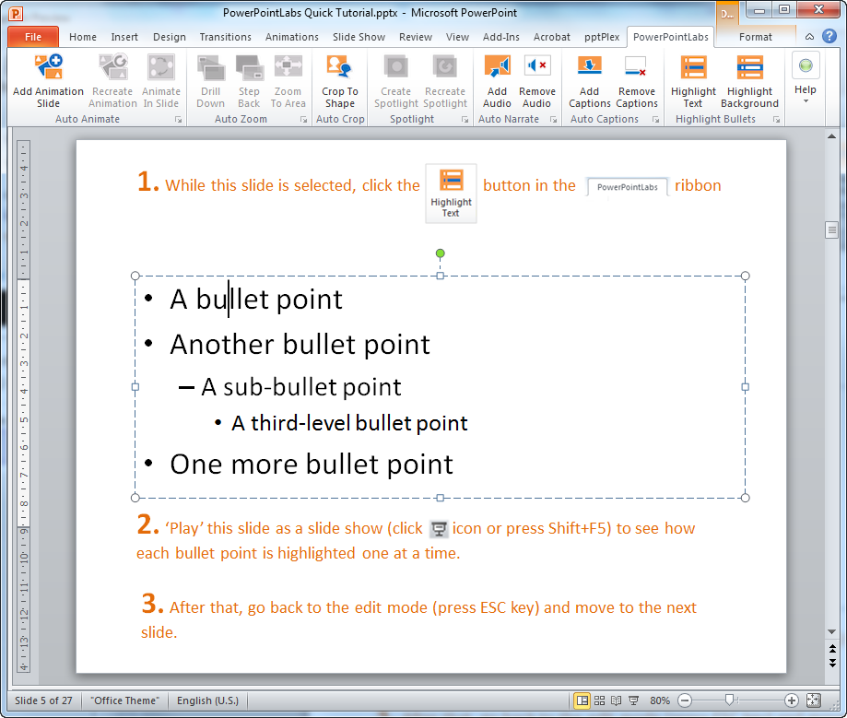
To indicate which point you are describing:
A bullet point
Another bullet point
A sub-bullet point
A third-level bullet point
One more bullet point

Slide 4


To indicate which point you are describing:
The result
A bullet point
Another bullet point
A sub-bullet point
A third-level bullet point
One more bullet point

Slide 5
To indicate which point you are describing:
A bullet point
Another bullet point
A sub-bullet point
A third-level bullet point
One more bullet point

Slide 6
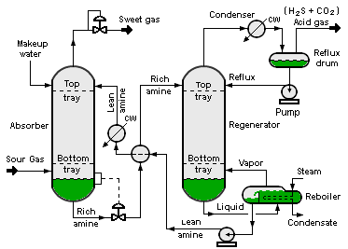
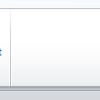
To show which part of the slide you are describing:
Draw shapes for areas you plan to describe
Animate in Slide
Image credit: Wikipedia

Slide 7
To show which part of the slide you are describing:
Draw shapes for areas you plan to describe
Animate in Slide
Image credit: Wikipedia

Slide 8
To show which part of the slide you are describing:
Works with other shapes too
Animate in Slide

Slide 9
To show which part of the slide you are describing:
Or you can create spotlight effects to highlight areas
Create Spotlight

Slide 10



To show which part of the slide you are describing:
Or you can create spotlight effects to highlight areas
Create Spotlight

Slide 11
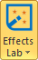
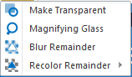
To show which part of the slide you are describing:
Or you can blur other areas to highlight some areas
Or you can create spotlight effects to highlight areas

Slide 12
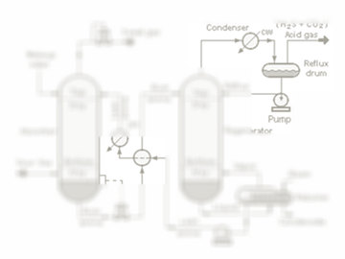
To show which part of the slide you are describing:
Or you can blur other areas to highlight some areas

Slide 13
To show which part of the slide you are describing:
Or you can recolor other areas to highlight some areas
Or you can blur other areas to highlight some areas

Slide 14
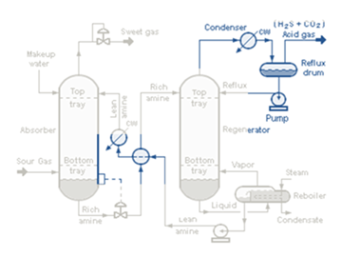
To show which part of the slide you are describing:
Or you can recolor other areas to highlight some areas

Slide 15
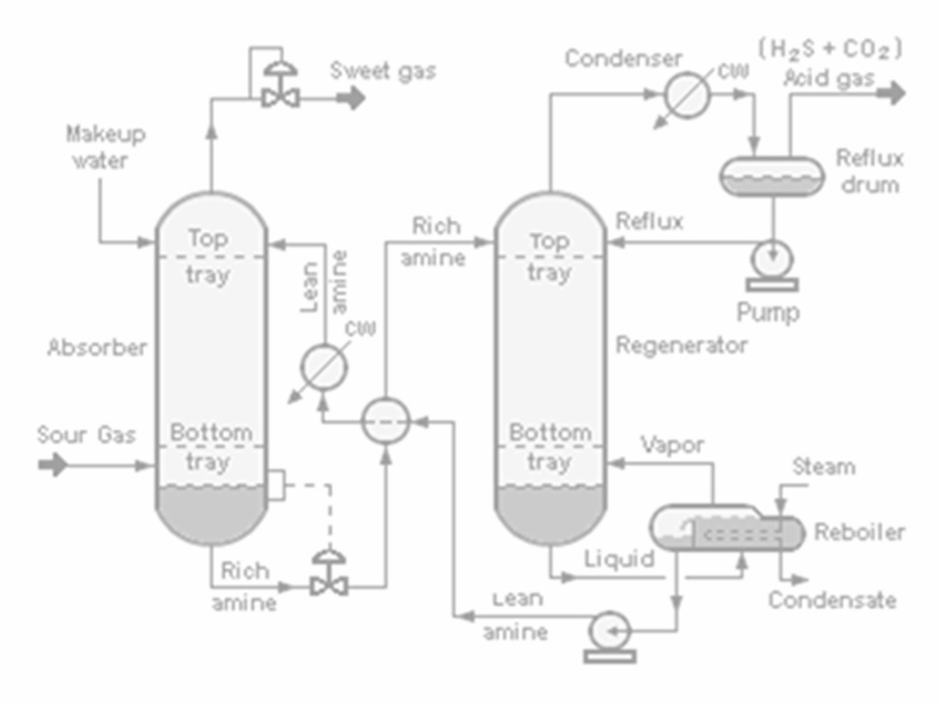
To show details of an area:
Draw a shape to mark the area

Slide 16
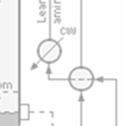
To show details of an area:
Draw a shape to mark the area

Slide 19
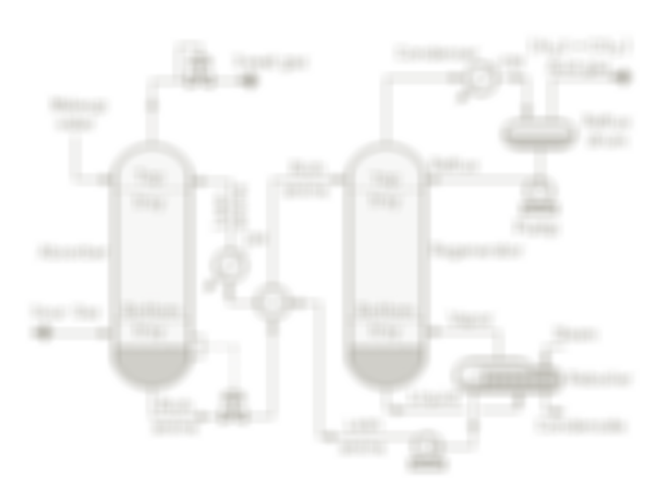
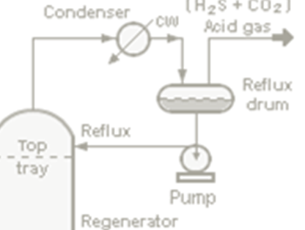
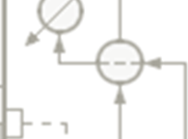

Slide 21
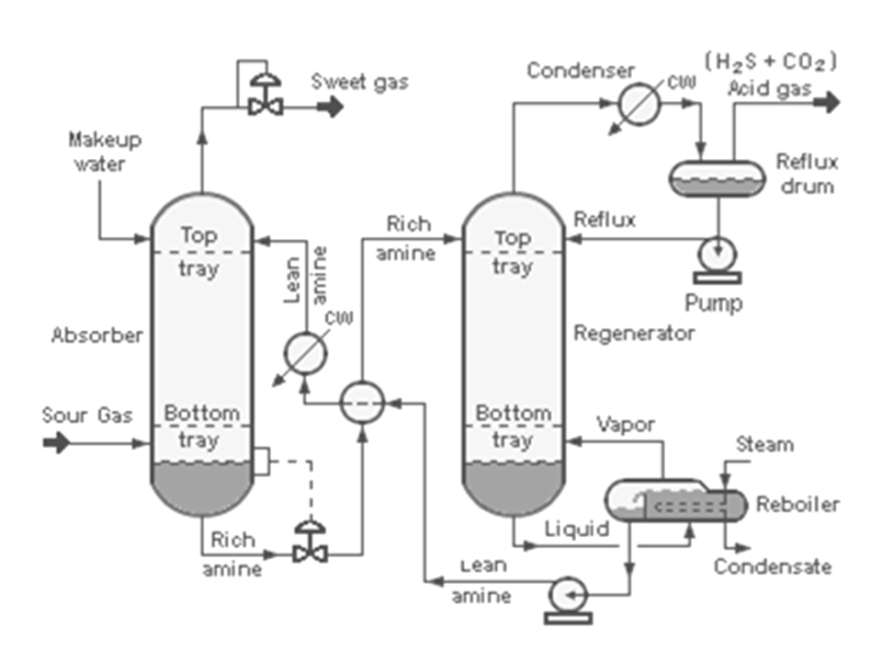
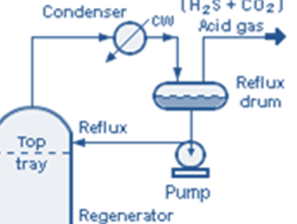
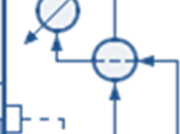

Slide 22
To create complex animations:
Create one slide with shapes in the start positions

Slide 23
To create complex animations:
Create one slide with shapes in the start positions
Create another slide with shapes in the end positions
Add Animation slide

Slide 24
To create complex animations:
Create one slide with shapes in the start positions
Create another slide with shapes in the end positions
Add Animation slide

Slide 25
To create complex animations:
Create one slide with shapes in the start positions
Create another slide with shapes in the start positions
Add Animation slide

Slide 26
To create complex animations:
Create one slide with shapes in the start positions
Create another slide with shapes in the end positions
Add Animation slide

Slide 27
To zoom into different areas of the slide:
Draw rectangles to mark areas to zoom into
Zoom to Area

Slide 28
To zoom into different areas of the slide:
Draw rectangles to mark areas to zoom into
Zoom to Area

Slide 29
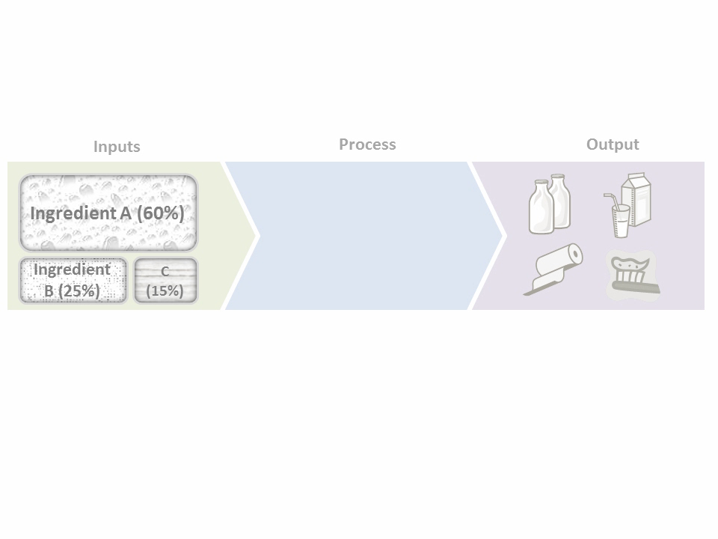


To zoom into different areas of the slide:
More advanced zoom in/out to show drill down and step back effects
Drill down
Step back

Slide 30
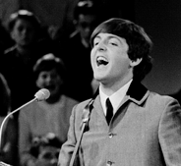
To show only a part of a picture:
Draw a shape to mark the area you want to cut out
A great quote said by
-a known person
Crop to Shape
Image credit: Wikipedia

Slide 31

To show only a part of a picture:
A great quote said by
-a known person
Crop to Shape

Slide 32
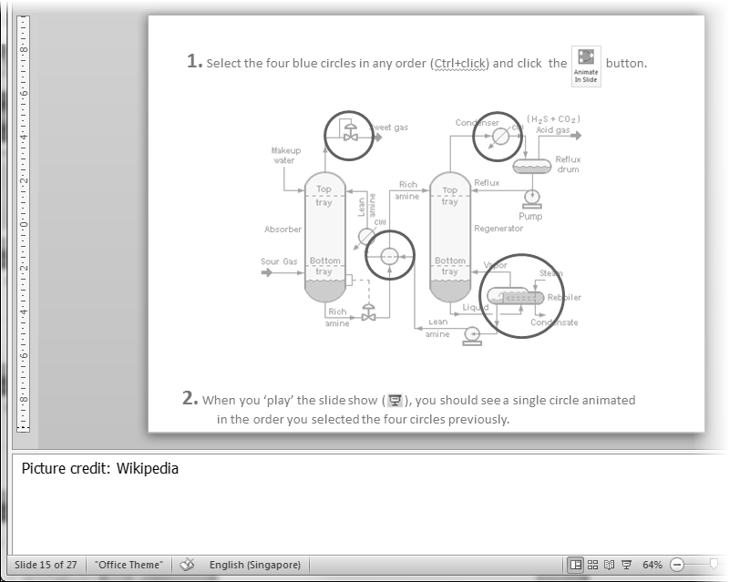
To add explanatory captions to self-study slides:
Add Captions
Type your explanations in the slide notes
Your explanations for the slide.
More explanations.

Slide 33
To add explanatory captions to self-study slides:
Add Captions
Animated captions added to slides automatically
Your explanations for the slide.
More explanations.

Slide 34
To generate audio narrations for slides:
Add Audio
Type what you want to ‘say’ in slide notes
Your explanations for the slide.

Slide 35
To generate audio narrations for slides:
Audio narration generated and embedded in the slide
Add Audio
Type what you want to ‘say’ in slide notes
Your explanations for the slide

Slide 36
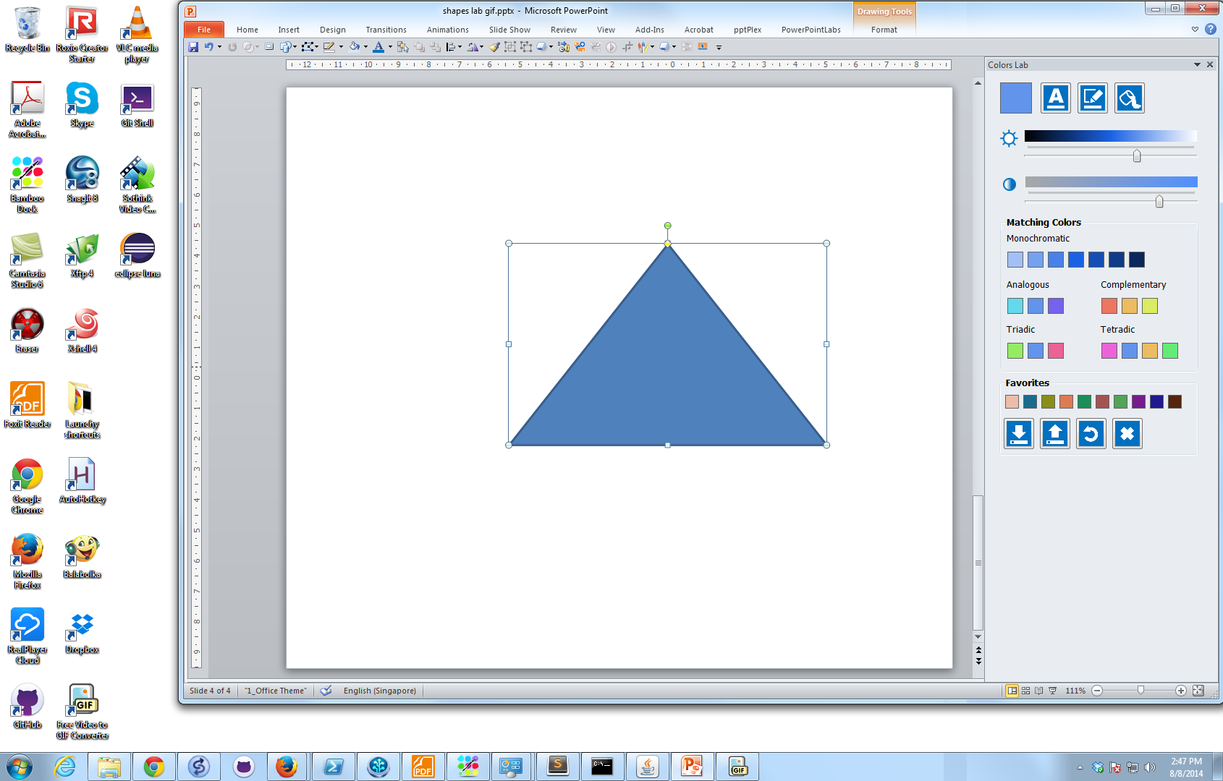


To pick colors from surroundings:
Pick colors from anywhere on the screen
Colors Lab

Slide 37

To pick colors from surroundings:
Pick colors from anywhere on the screen
Colors Lab
Catchy slogan!
Catchy slogan!
Catchy slogan!
Live preview

Slide 38
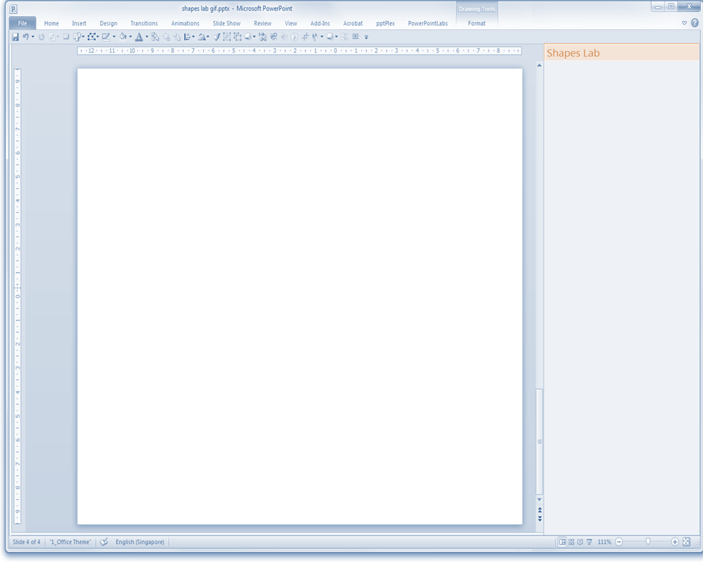

Save and reuse shapes:
Shapes Lab
Save shapes for later use

Slide 39
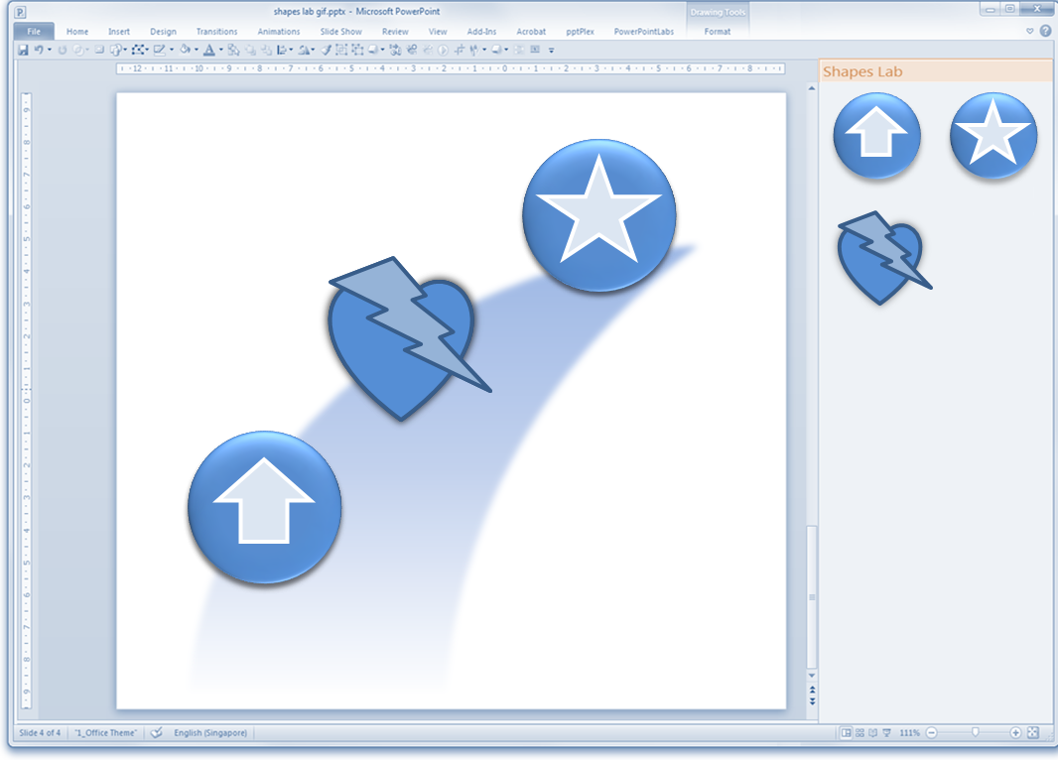
Save and reuse shapes:

Slide 40
Save and reuse shapes:
Shapes Lab
Save shapes for later use

Slide 41
Save and reuse shapes:
Shapes Lab
Save shapes for later use
Reuse in other presentations

Slide 42

This video was created using PowerPointLabs
A free add-in for PowerPoint 2010 and 2013
This video was created using PowerPointLabs
Get it from http://PowerPointLabs.info

Slide 43
Title: Use PowerPoint a lot? This two-minute video will save you a ton of time.
Description:
Use PowerPoint a lot? This two-minute video will save you a ton of time. A feature demo of the free PowerPointLabs add-in for Microsoft PowerPoint 2010 and 2013.
Keywords:
Microsoft PowerPoint
presentation
Free
Add-in
plugin demo zoom crop animate spotlight highlight pick colors save shapes

Slide 44
